Slide 1
Our Life Magazine
Designed & Presented by:
Jessica Bain, Kenny Berrouet, Hsin Yu Chao,
Kevin Caffrey, Tyler Chiapperino

Slide 2
About “Our Life” Magazine
Inspire young African Americans to achieve high levels of success
African American success doesn’t have to be from just athletes & entertainers
Subscribers across US
Mainly East and West coast

Slide 3
Problems with “Our Life” magazine
Unorganization of customer data and info
High turnover of customers
Poor feedback
Long response time

Slide 4
Our Database’s Solutions
Improve organization of customer information
Enhance customer feedback experience
Increase business efficiency
Improve customer communication

Slide 5
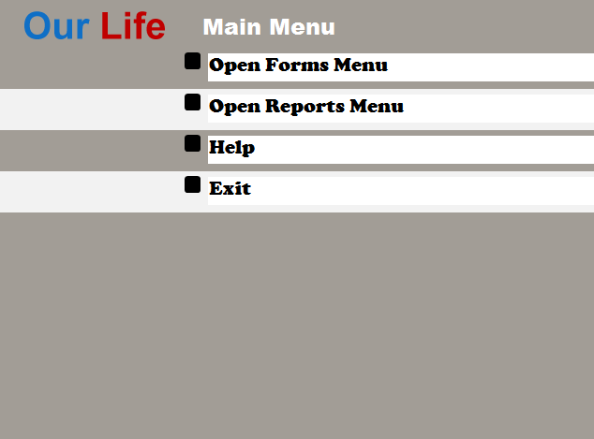

Slide 6
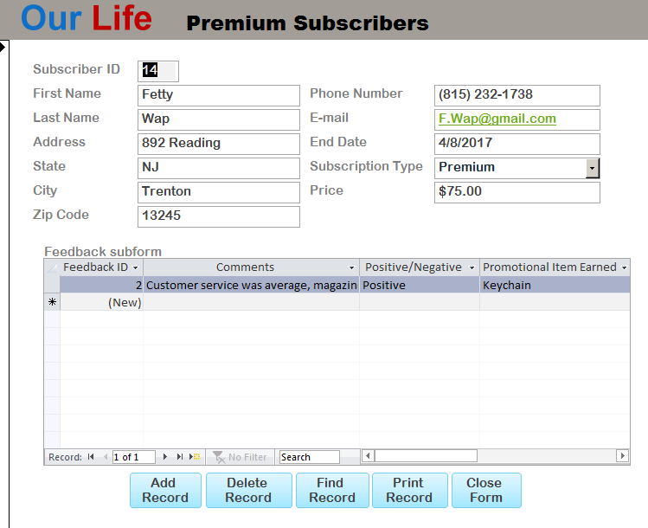
Forms
Feedback Subform
Premium Subscribers
Standard Subscribers
Subscribers
Switchboard

Slide 7
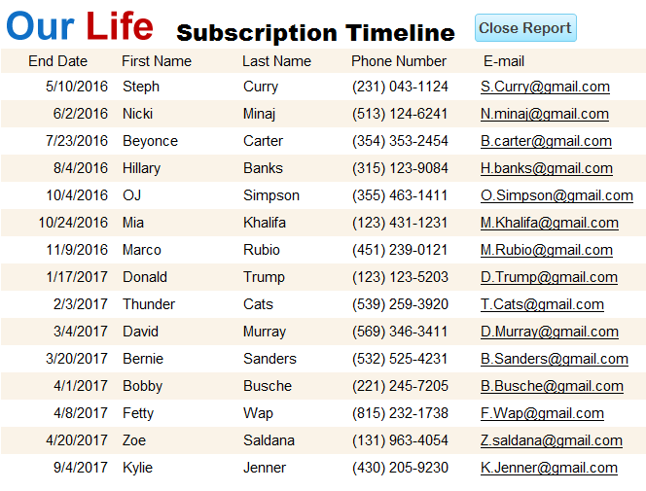
Reports
Demographic Experience
No Promotional Item Received
Subscriber Feedback
Subscribers by State
Subscription Timeline

Slide 8
Query
Demographic experience
No Promotional Item Received
Premium Subscribers
Standard Subscribers
Subscriber Feedback

Slide 9
Example

Slide 10
ANY QUESTIONS?

Slide 11
THANK YOU!

